Slide 1


Kithul Treacle and Kithul jaggery Maker
Group No:18

Slide 2

205108G
Thennakoon T.M.M.S
Stepper Motor and Driver
Keypad

Slide 3
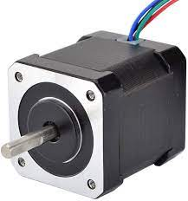
Stepper Motor
When the container is filled with sap, motor stars to rotate and it continues until the temperature set to set temperature.
When the user increases the set temperature after the process is done, motor starts again rotating until temperature set with the new set temperature.
c

Slide 4
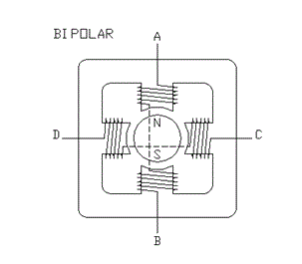
Bipolar Stepper Winding Arrangement
Manufacturer Part Number: 23HP22-2804S
Number Of Phase: 2
Step Angle: 1.8 deg
Holding Torque: 1.26 Nm(178.4oz.in)
Rated Current/phase: 2.8 A
Link to the Data sheet:
https://www.omc-stepperonline.com/download/23HS22-2804S.pdf

Slide 5
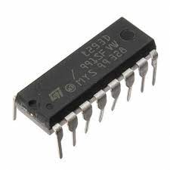
L293D driver
Specifications:
Type: Half Bridge
Operating Supply Voltage: 4.5 V to 36 V
Output Current :600 mA
Operating Supply Current: 2 mA
Minimum Operating Temperature: - 40 C
Maximum Operating Temperature: + 150 C
Unit Weight: 270 mg
Number of Outputs: 2 Output

Slide 6
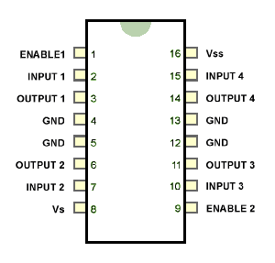
Pin diagram of L293D
Link to the Data sheet:
https://cdn-shop.adafruit.com/datasheets/l293d.pdf

Slide 7
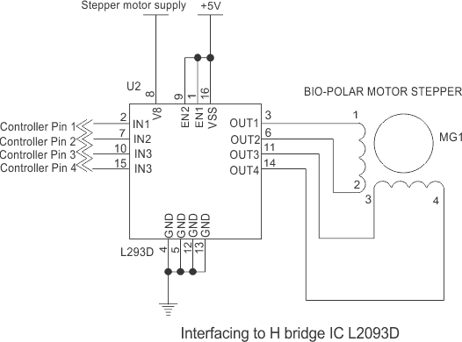
Interfacing L293D with Bipolar Stepper

Slide 8
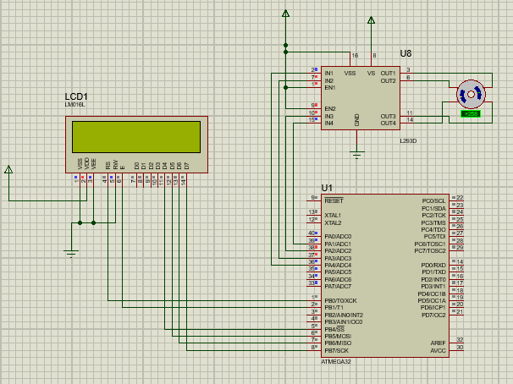
Stepper Motor And Driver interfacing Proteus

Slide 9
Code - Stepper Motor And Driver
#define F_CPU 8000000UL
#include <avr/io.h>
#include <util/delay.h>
void stepper();
int main(void)
{
DDRA = 0xFF;
PORTA = 0x00;
/* Replace with your application code */
stepper();
}
void stepper(){
//All pins of PORTC as output //Initially all pins as output high
while(1)
{
PORTA = 0b00010010;
_delay_ms(100);
PORTA = 0b00000110;
_delay_ms(100);
PORTA = 0b00001100;
_delay_ms(100);
PORTA = 0b00011000;
_delay_ms(100);
}
}

Slide 10
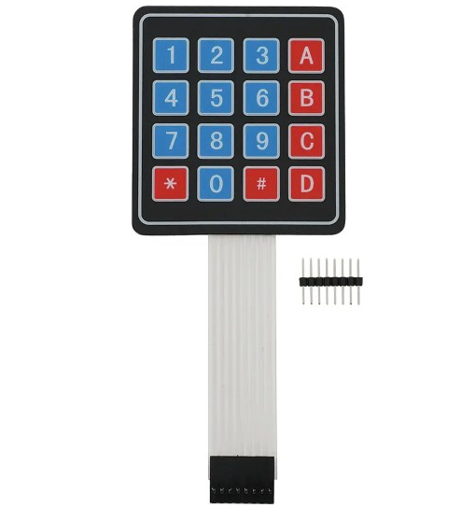
Keypad
Selecting options - makes the user go through the specific process. When the user selects an option, the system sets the defaults (temperature limit, valve no) for the specific product.
Increase the default set temperature to continue the process if the user is not satisfied with the output product.
Open/ Close valve

Slide 11
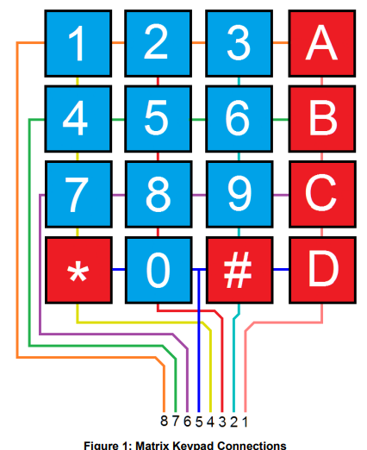
Keypad (Cont.)
Key Features:
Ultra-thin design & adhesive backing
Easy communication with any microcontroller
Cable included
Details:
Maximum Rating: 24 VDC, 30 mA
Interface: 8-pin access to 4×4 matrix
Dimensions: Keypad: 2.7 x 3.0 in (6.9 x 7.6 cm)
Cable: 0.78 x 3.5 in (2.0 x 8.8 cm)
Operating temp range: 32 to 122 °F (0 to 50 °C

Slide 12
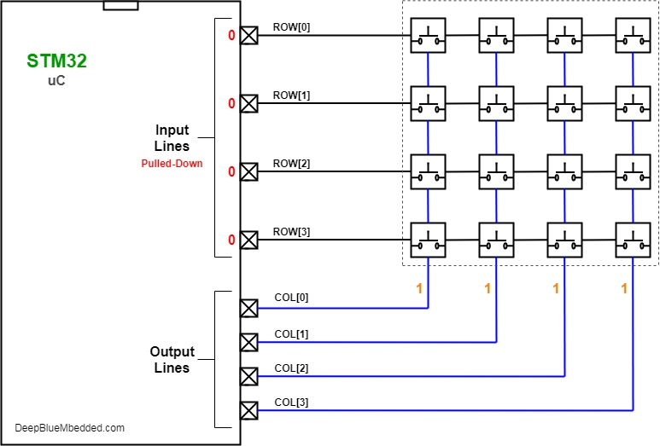
Interfacing Keypad
Link to datasheet-
http://www.electronicoscaldas.com/datasheet/Teclado-membrana-matricial-4x4.pdf

Slide 13
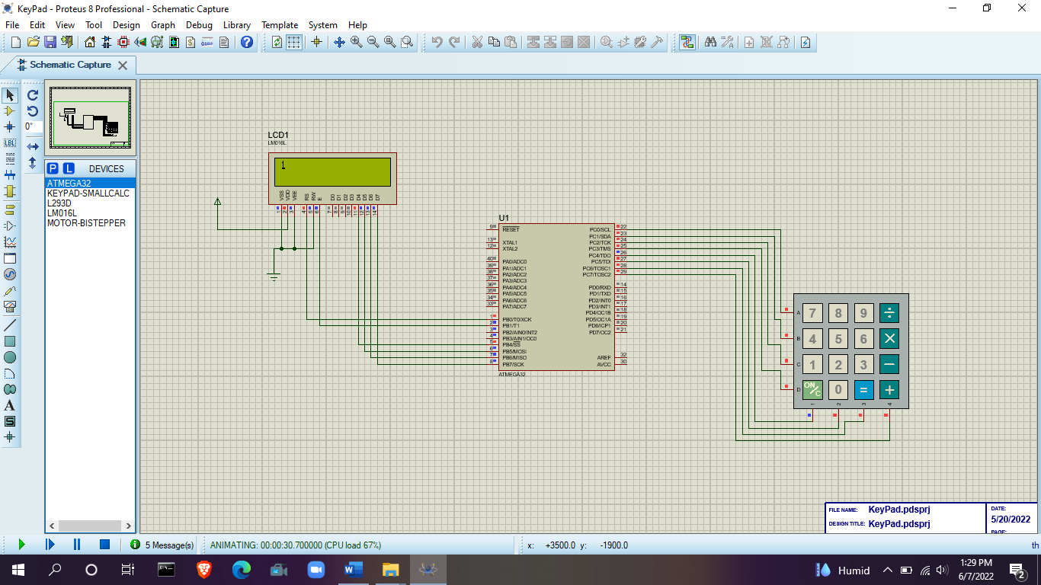
Keypad Interfacing Proteus

Slide 14
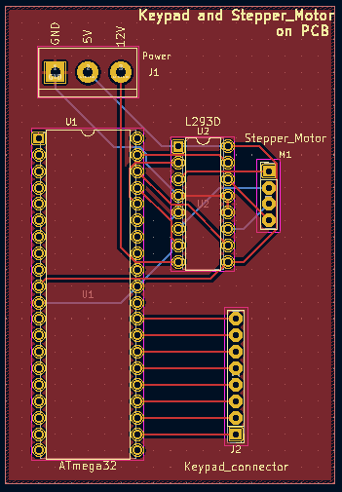
PCB Design

Slide 15
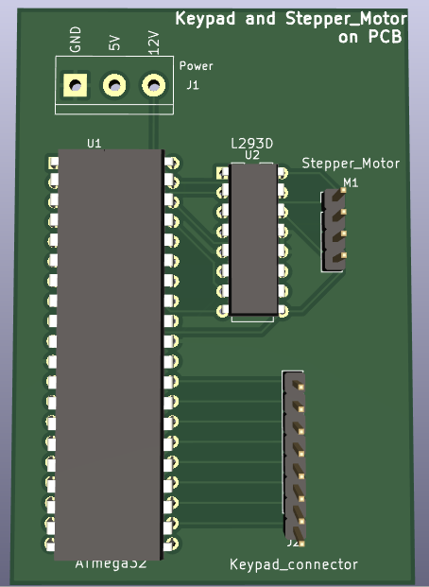
3D View

